Slide 1
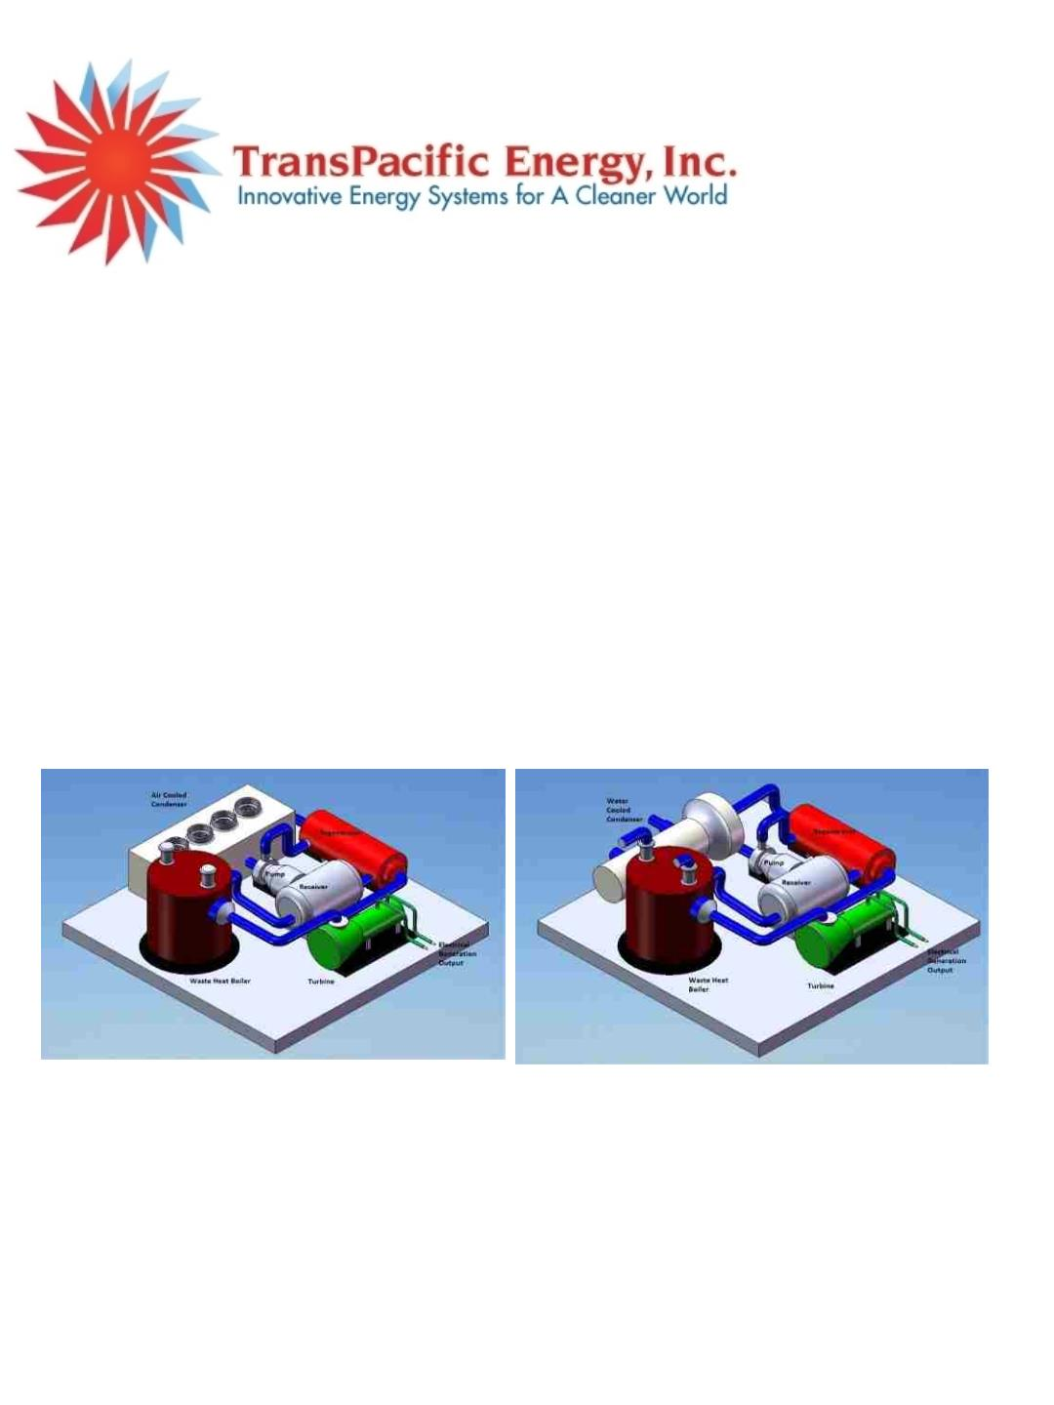
TransPacific Energy (TPE) is a high-tech corporation that designs, builds, owns, operates, sells
and installs proprietary, modular Organic Rankine Cycle (“ORC”) utilizing multiple
refrigerant mixtures to maximize heat recovery and convert waste heat directly (75F to
950F) from industrial processes, solar and geothermal, biomass converting it into electrical
energy. TPE technology can also be utilized as alternative to cooling towers, steam
condensers and use heat released to efficiently generate electricity with air-cooled or
water-cooled condensers. TPE also expands its Renewable Energy activities, for more
information and details, visit our web site www.transpacenergy.com
TPE™ uses multi component fluids environmentally sound nontoxic, nonflammable, in contrast
to the typical Organic Rankine Cycle that uses binary cycles and organic fluids such as
pentane, isobutene, butane, propane and ammonia instead of water.
Count on TransPacific Energy efficient waste heat recovery for power generation using its
propriety and renewable energy technologies. Other applications include solar,
geothermal energy as well as warm ocean waters. We deliver innovative solutions for
cleaner greener world. Help us stop global warming with our green energy conversion
technology.
Contact us;
TransPacific Energy, Inc
204 West Spear Street
Carson City, NV 89703
Tel: 619 272 9131, 760 659 8460 (WhatsApp)
Email: information@transpacenergy.com

Slide 2
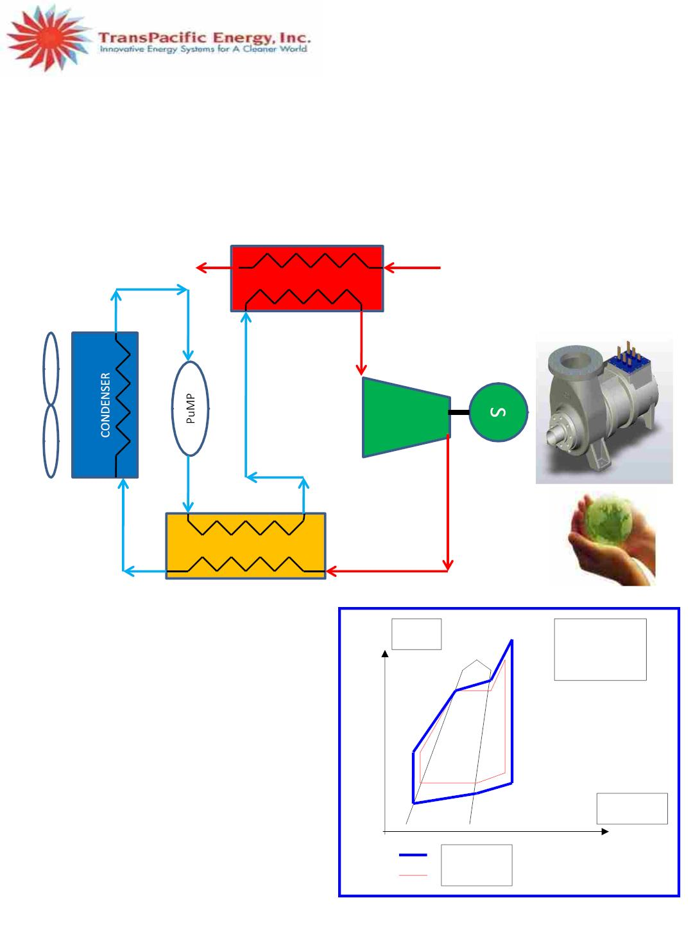
www.transpacenergy.com
Tel: 1-619 272 9131
ORGANIC RANKINE CYCLE ORC
The Rankine cycle is a closed loop thermodynamic cycle with a working fluid where an external heat source
generates steam at its boiler. Water is the working fluid. Steam turbines, installed in power plants (coal fired,
nuclear or biomass) are based on the cycle. In an Organic Rankine cycle (ORC), the working fluid is not water
but an organic fluid such as butane or pentane, ammonia etc. This cycle is more suitable for low temperature
and medium heat source applications than steam cycle.
BOILER
HEAT SOURCE
hot water
5
Dry and wet gases
1
2
TURBINE
6
3
4
REGENERATOR
Entropy
TPE’s Organic
Rankine Cycle
ORC
1-2: The organic fluid (blend) is vaporized and
superheated
in the evaporator
2-3: The organic vapor is expanded through the
turbine
3-4: Expanded vapor heat up the organic liquid
4-5: Vapor is condensed
5-6: Organic liquid is pumped
6-1: Organic liquid is heated up with vapor from
turbine outlet
Temperature
Blend
Single fluid

Slide 3

TPE
Value proposition: Why Refrigerant Mixtures?!!
· Pure Refrigerants boil at constant but blends boil at
variable saturation temperatures.
·Benefits of TPE refrigerant Mixtures:
T
·
Unique ability to customize refrigerant
mixture for maximum heat recovery, less
heat losses and power production.
Heat
Mixture
Pure
Fluid
·
·
Efficient Heat Recovery Direct and
Indirect: (80-1000F)
Wide applications:
-Hot fluids: Gray water, Solar,
Geothermal
-Hot gases: Flue gases, Hot air
·
·
·
Economically viable
L
Environmentally sound
Built as per Industry Standards

Slide 4
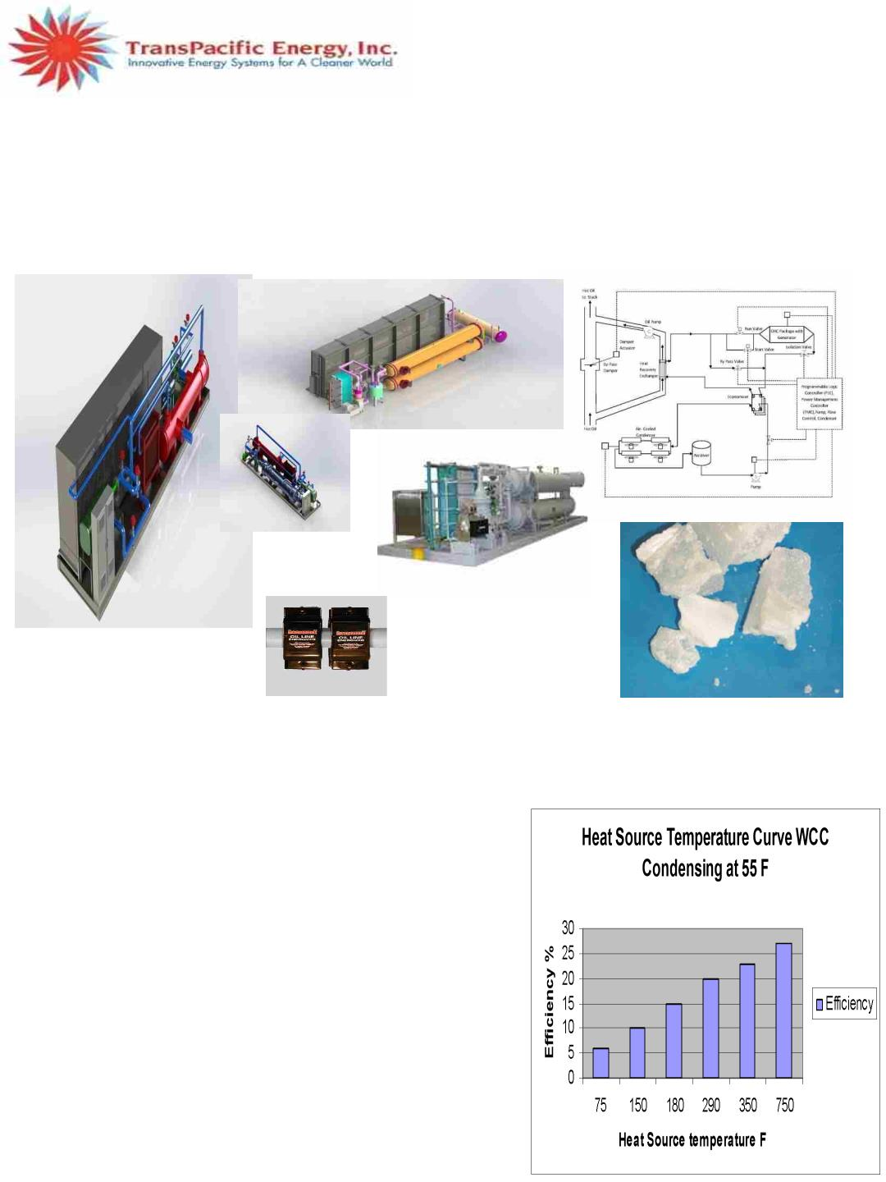
www.transpacenergy.com
Tel: 1-619 272 9131
TransPacific Energy (TPE) ORC uses environmentally sound refrigerant mixtures (blend)
formulated to maximize heat recovery at heat source temperatures from 25°C up to 500°C with
enhanced electrical efficiency up to 35%. This permits a wide range of applications of the TPE ORC
to generate power from waste and untapped heat sources such as liquid and effluent flue gases.
Typical turbo generator shown below is for illustration purposes only and final product may vary.
TPE ORC ADVANTAGES:
ØEnhanced Heat to power electrical efficiency
ØVariable boiling temperature to enhance heat recovery
ØHermetically sealed, no gear box
ØAvailability higher than 80% and efficient at wide range of temperatures
ØEasy to install and limited footprint (skid mounted)
ØSimple automated operation, PM and Ethernet PLC
ØLow operation and maintenance cost
ØInnovative certified refrigerant mixture
ØNonflammable, nontoxic working fluids
ØBroad Temperature Applications
ØThermal storage uses patent technology; environmentally
sound phase change material that meets codes and flame
spread standards, and provides 24/7 power for solar,
geothermal and load shaving
ØEnvironmentally sound; no fuel consumption,
reduce carbon emission, and greenhouse gases,
zero acid rain.
TPE ORC UNITS:
•Custom-made & turn-key Systems: 100 KW to 5,000 KW
•Multiple, Split and Cascade units.

Slide 5
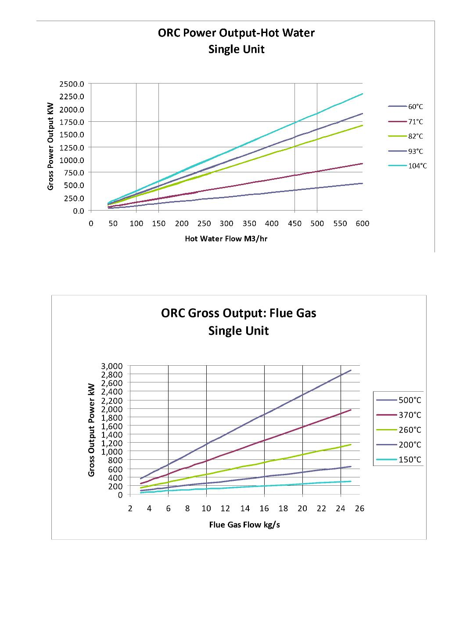

Slide 6
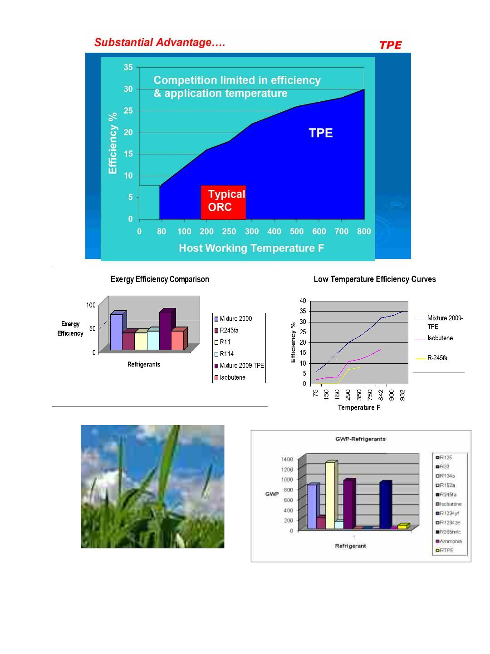
Intellectual Properties:
•
•
•
Electric Power Generator Using a Rankine Cycle Drive with Refrigerant Mixtures and Exhaust Combustion
Products as a Heat Source, US Patent, USPO 8276383, 2012.
Power Generator using a Wind Turbine, a Hydrodynamic Retarder and Organic Rankine Cycle drive, US
Patent Pending, 2010.
Methods and Apparatus for Thermal Storage using Heat Pipes, US Patent-, USPO 7891575, 2011

Slide 7
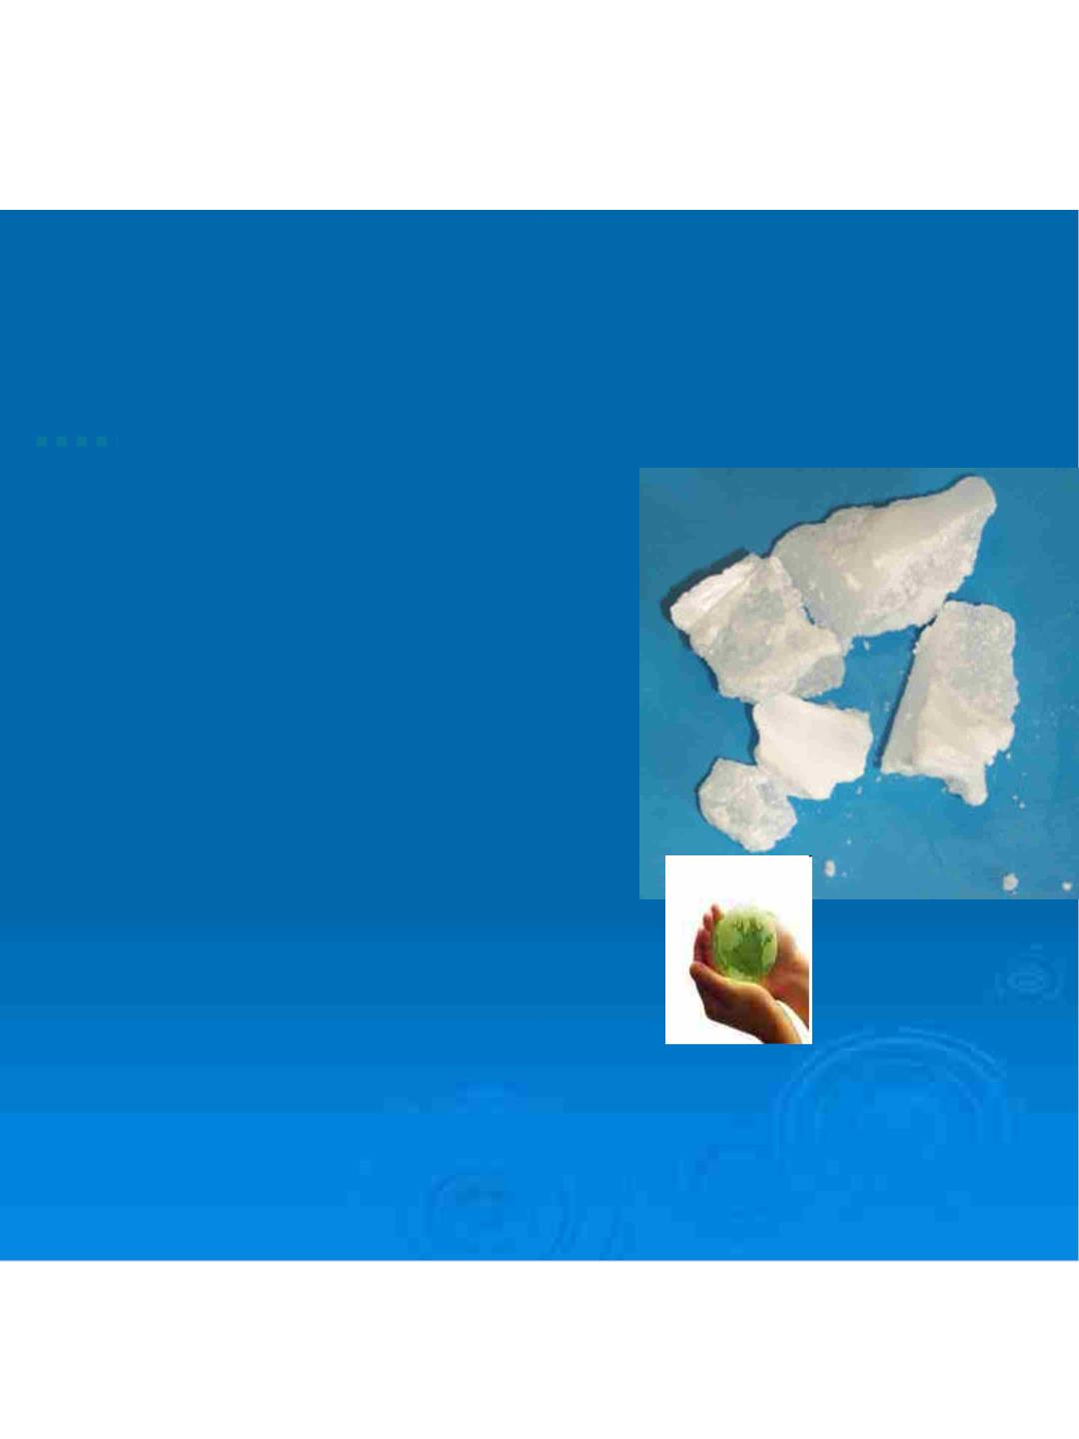
TPE
Thermal Storage…. Black Wax Paraffin
Innovative Technology
·
·
Provides 24/7 continuous supply of
power
·
·
·
·
·
Ensures 24/7 continuous supply of heat
or cooling
Enables change of state at
predetermined temperatures
Can be used with forced air or liquid
coolant flow
Environmentally sound, meets codes
and flame spread standards
Applications: Solar, Geothermal and
load shifting

Slide 8
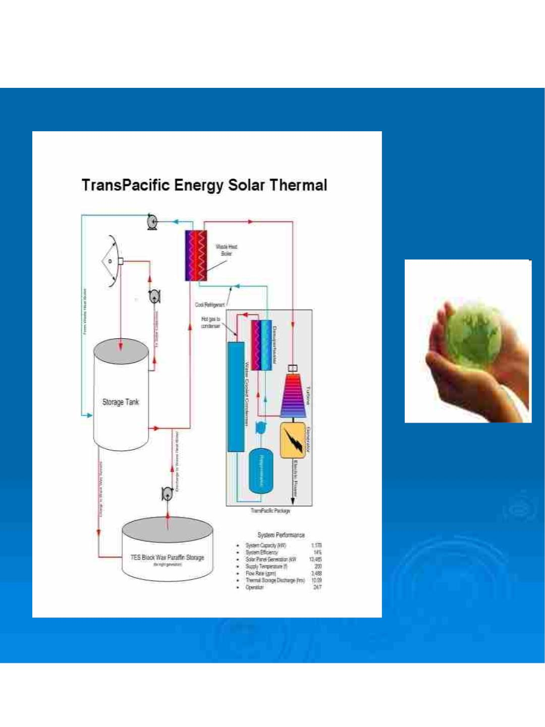
TPE

Slide 9
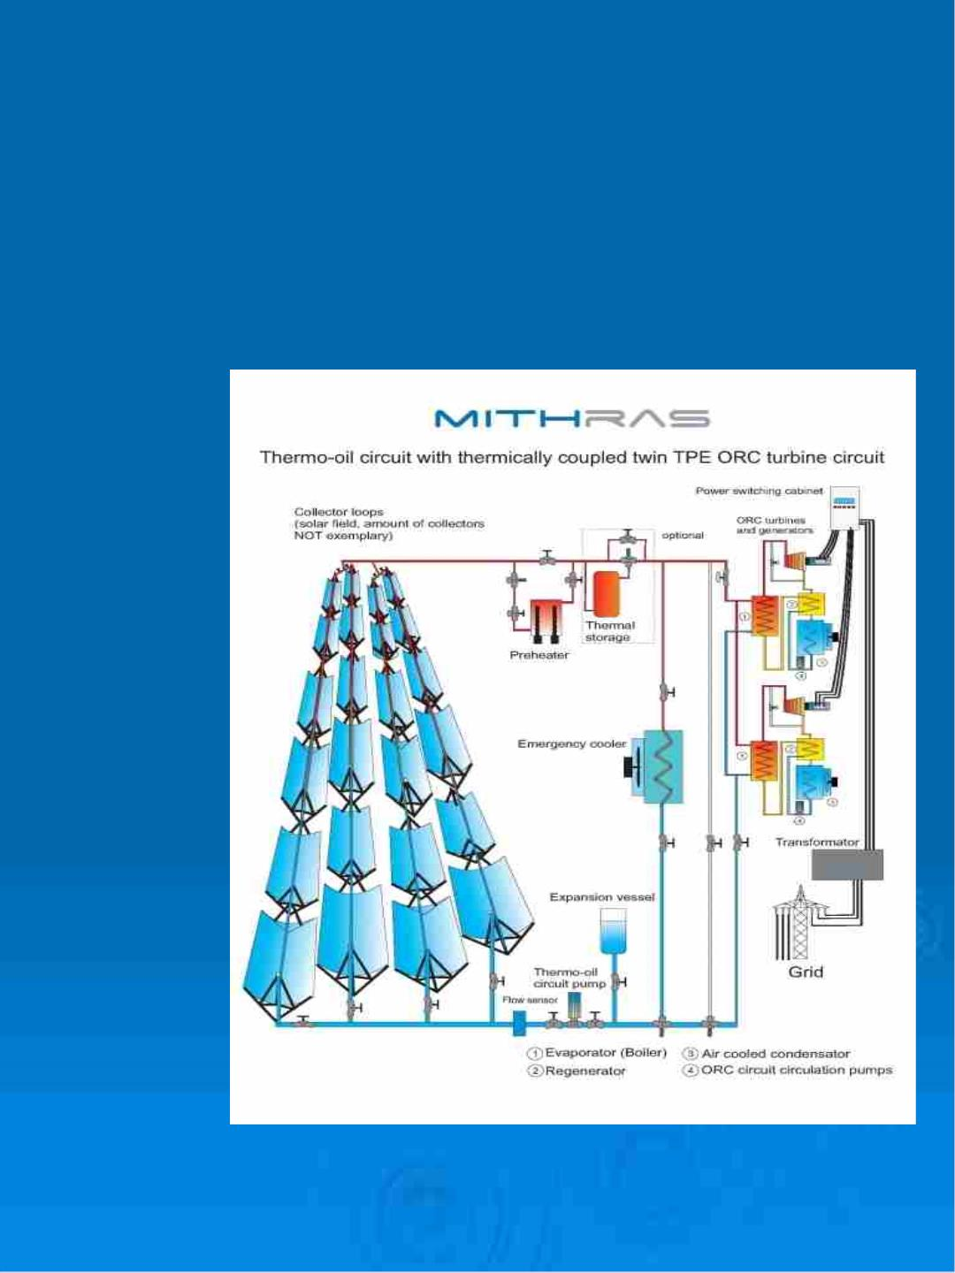
Thermal Solar CSP -ORC …….
TPE
•Thermal Solar
Plant
•10 MW

Slide 10
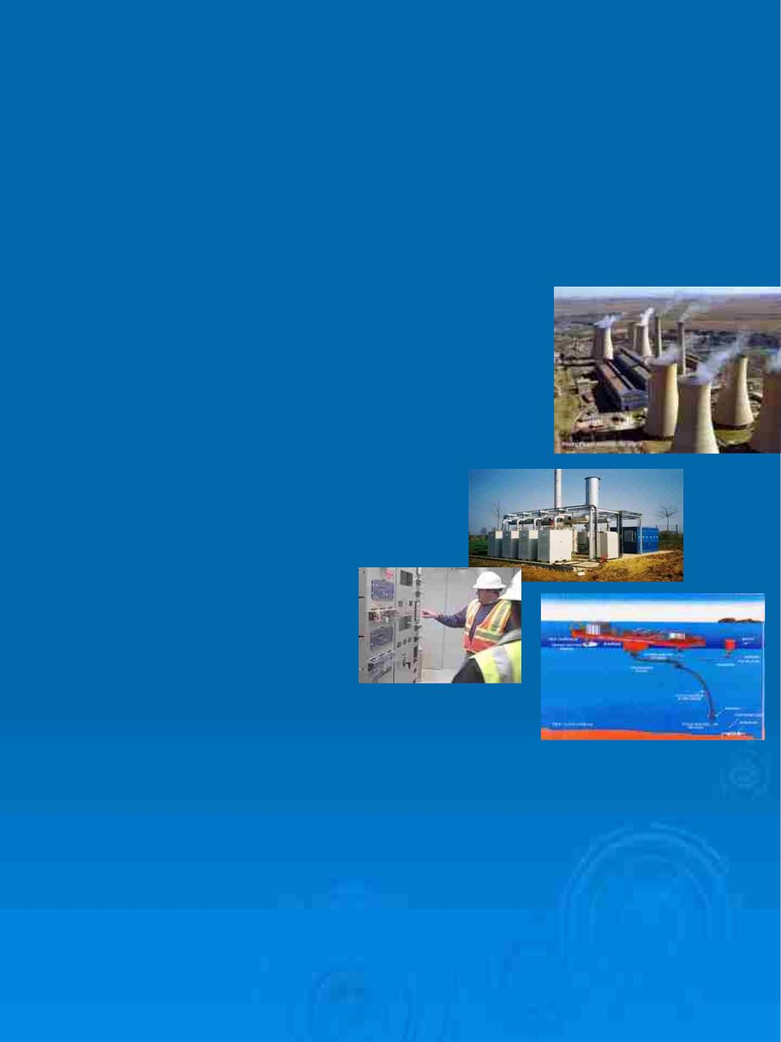
Market…
TPE
Customers Worldwide…
Hot gas or Hot fluid applications;
•PPP using fossil fuel
•Solar and Geothermal power plants
•Food processing facilities
•Petrochemical refinery installations
•Abundant/Live oil wells
•Desalination process
•Biomass applications
•MWD sites
•Marine transport
•Ocean warm waters (OTEC)
•Cooling Tower replacements and substitutes
•Condenser Alternatives
•Various DOD applications

Slide 11

Market… Current and Future
TPE

Slide 12
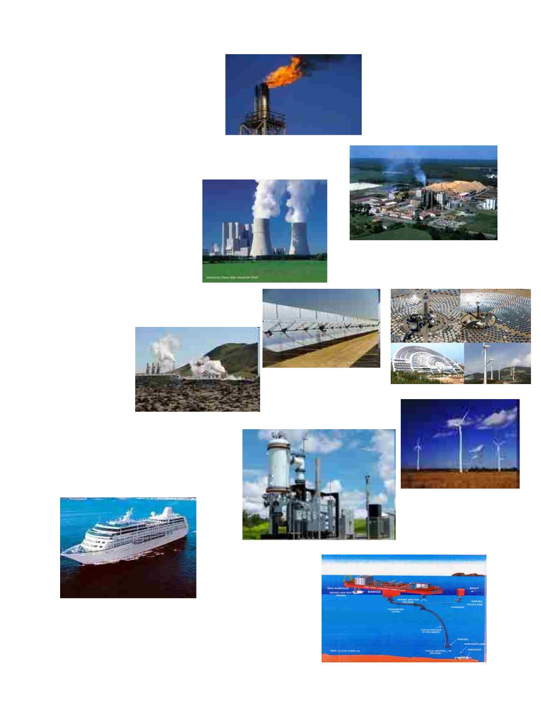
FIELD APPLICATIONS OF TPE ORC
GAS FLARE:
ØWaste landfill
ØWaste water treatment plant
ØRefineries
ØPetrochemical industries
INDUSTRY EFFLUENT:
ØPaper industry
ØGlass industry
ØCement industry
ØFood industry (sugar, milk,…)
ØBiofuel
THERMAL
PLANTS:
ØAll fossil fuel
ØSolar thermal
ØGeothermal
Ø. Energy storage
POWER PLANTS:
ØCogeneration (gas turbine and engines)
ØBiomass
ØBiogas
ØWind turbine
OCEAN THERMAL ENERGY:
ØCoastal activities
ØOffshore platform
ØOcean Thermal Energy Conversion (OTEC)

Slide 13

TransPacific Energy Renewable
Technologies
• PV Solar Panels
• PV-Thermal Solar
• CSP Solar Integrated ORC
• Geothermal Energy
• Biomass Energy
• Hybrid System for Remote Areas
• Solar Clean Water Generators
• Solar Lights
• Desalination by PV-Thermal
• Fuel Cell driven by Solar and Wind
Energy for Hydrogen Production
and Storage

Slide 14
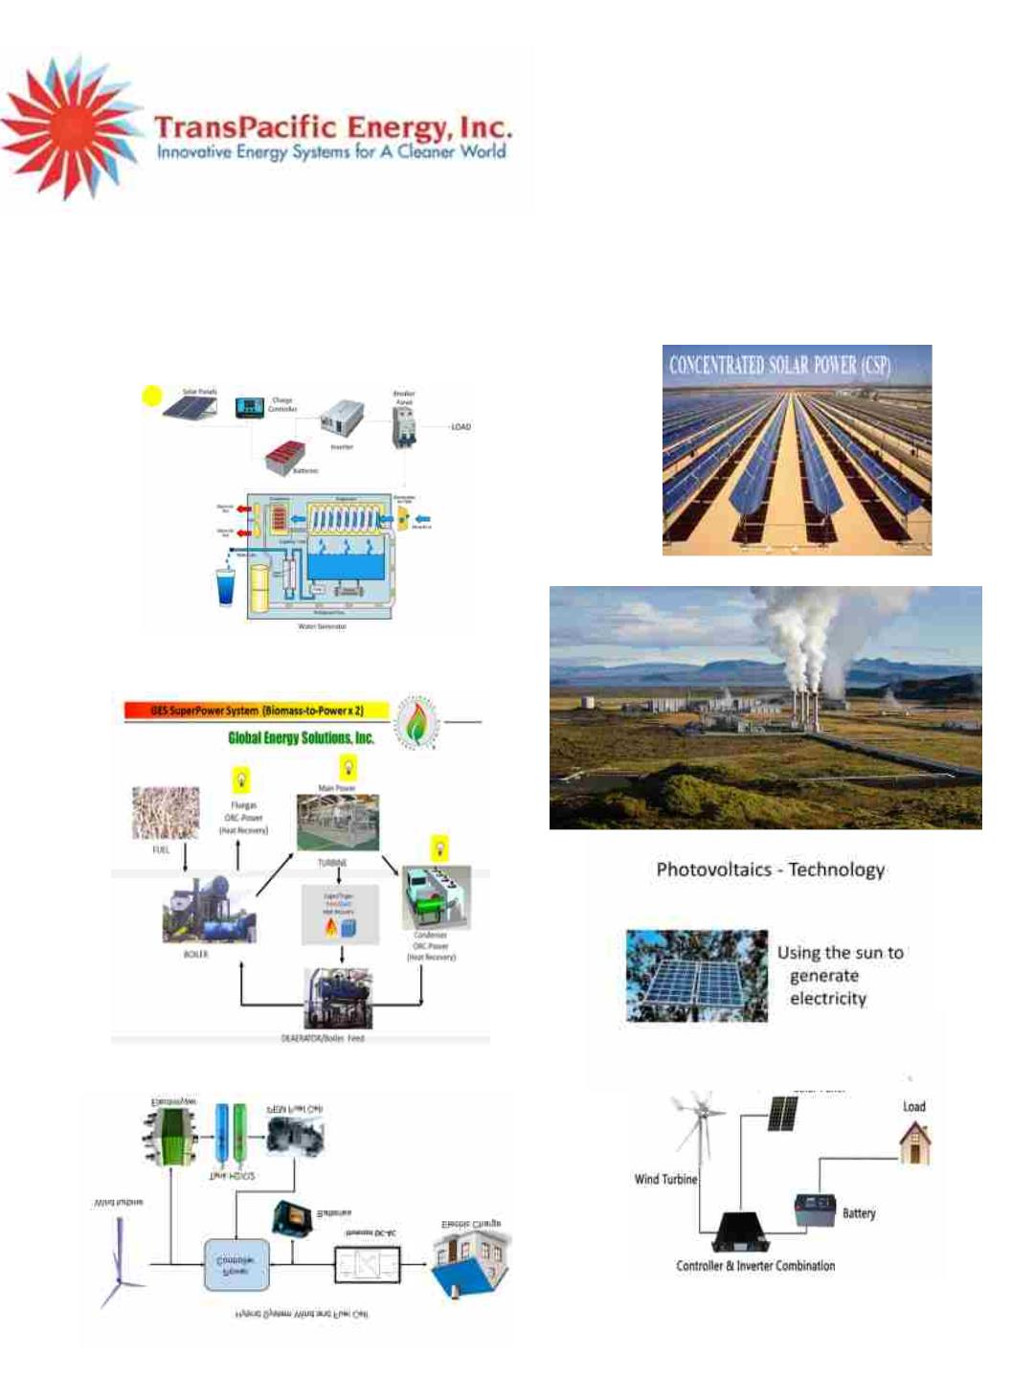
TransPacific Energy Renewable Energy
Technologies

Slide 15
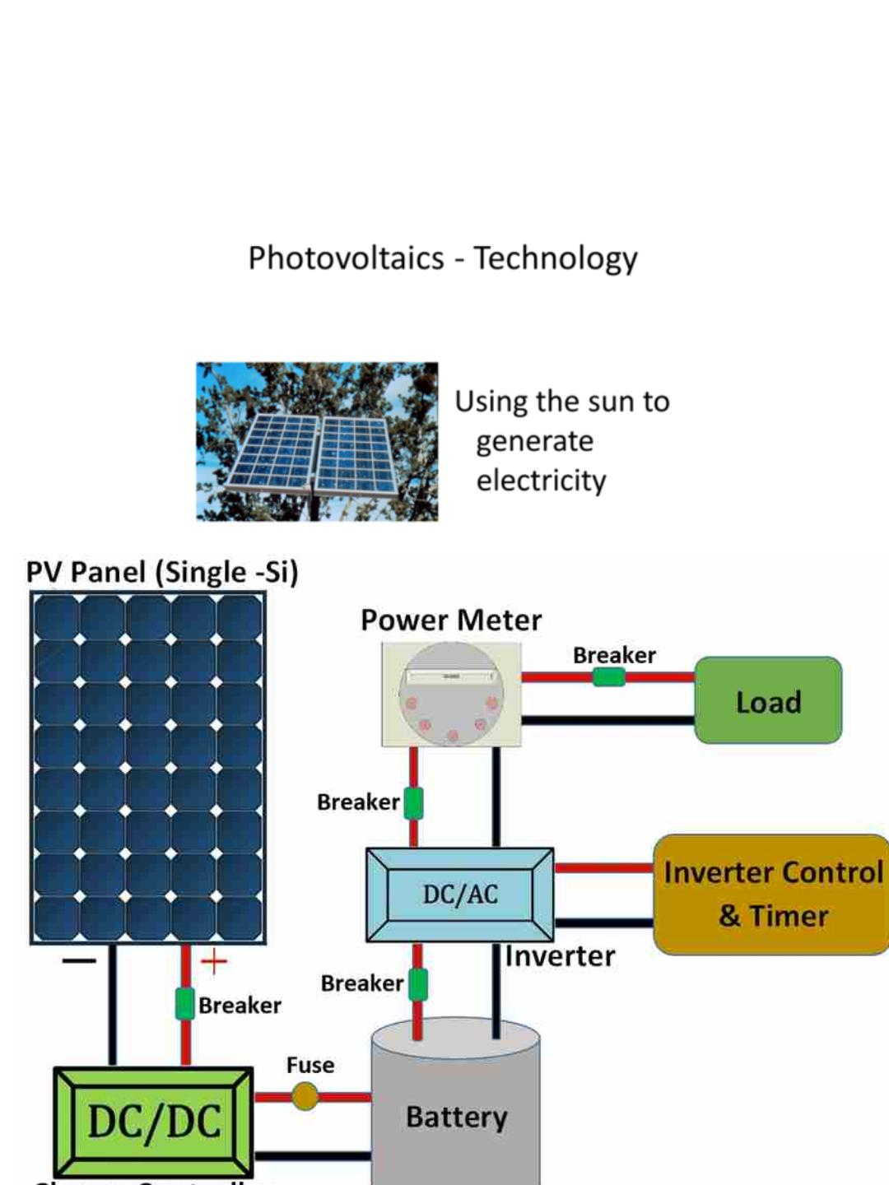
TransPacific Energy Solar Technology

Slide 16
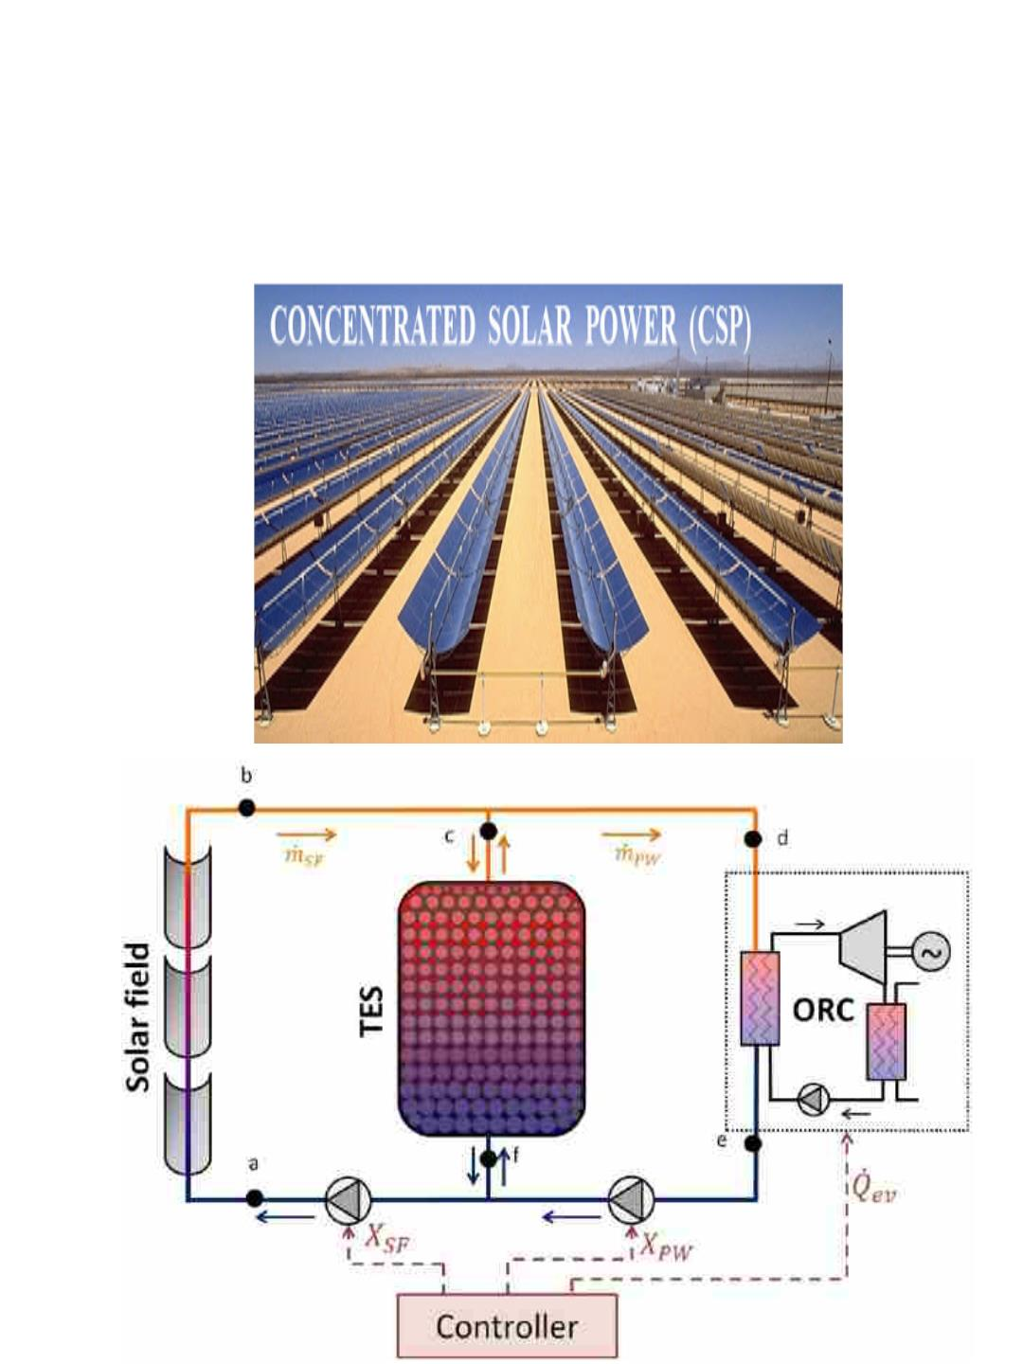
CSP Integrated ORC Technology

Slide 17
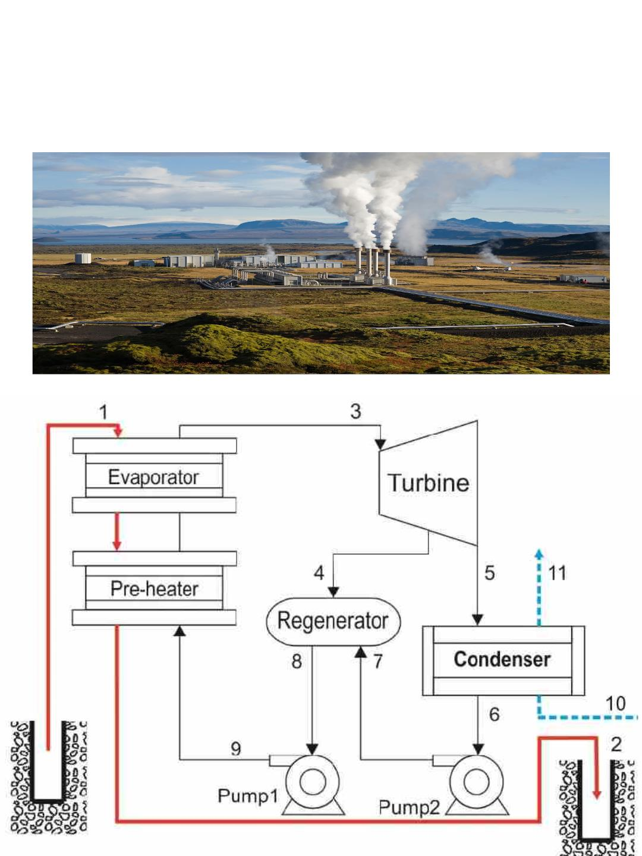
TransPacific Energy Geothermal
Technology

Slide 18
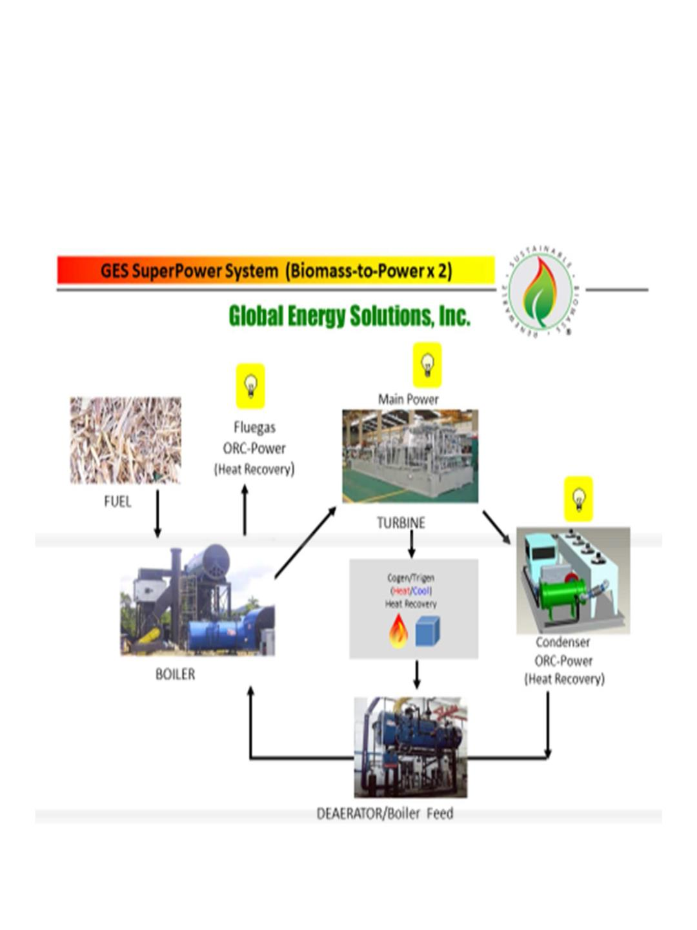
Biomass Energy Power
Generation

Slide 19
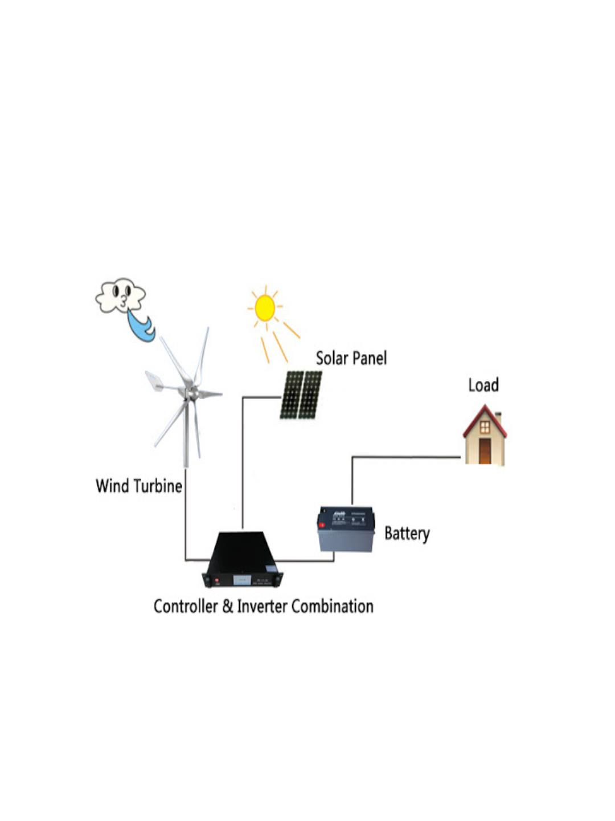
TransPacific Energy Hybrid Technology

Slide 20
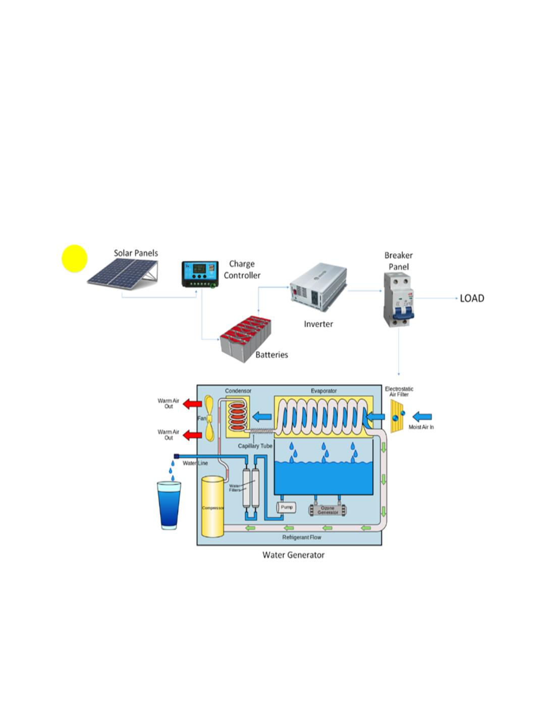
TransPacific Energy Solar Water
Generator

Slide 21
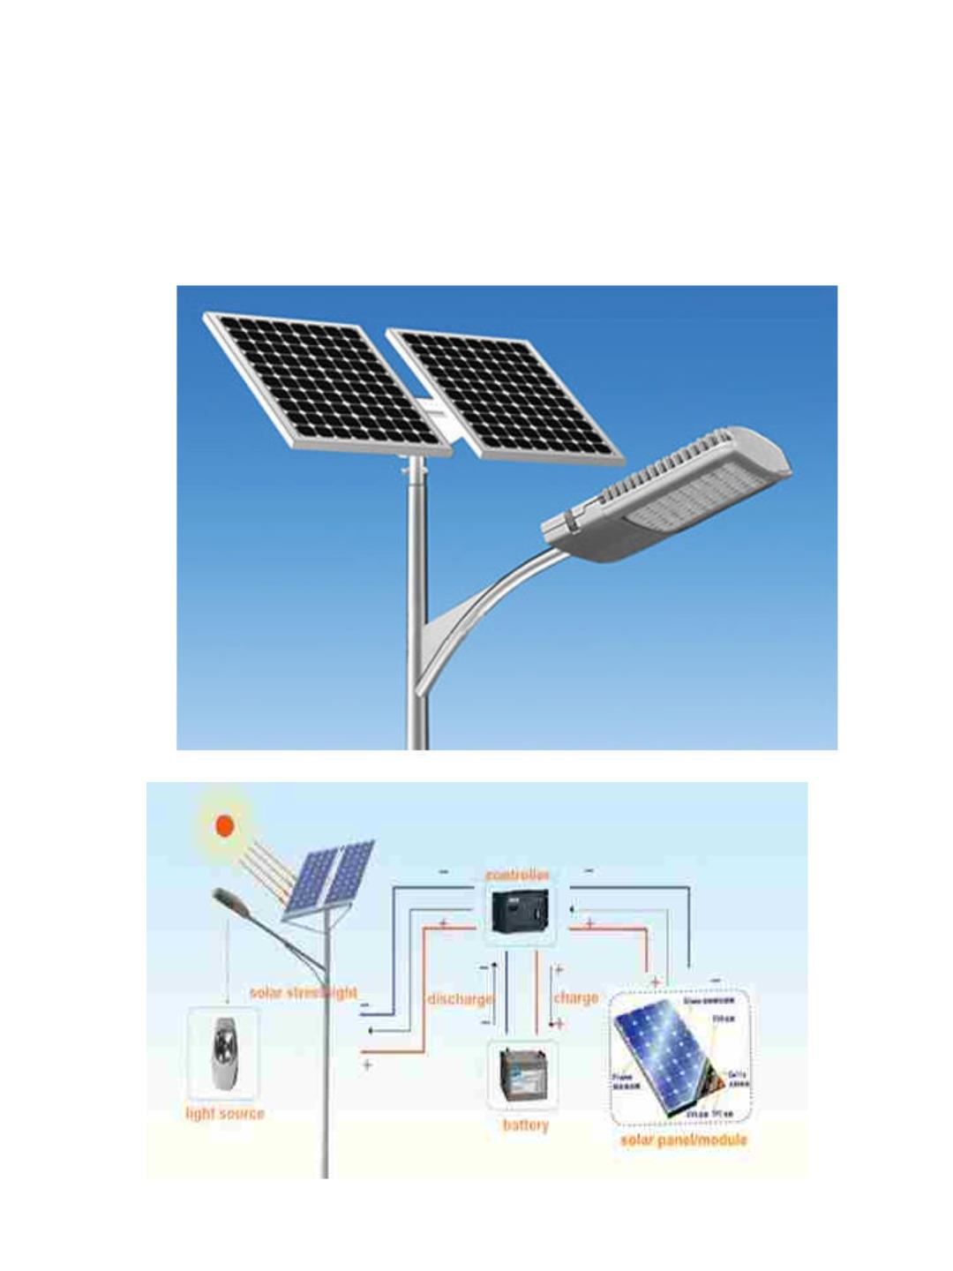
TransPacific Energy Solar Lights

Slide 22
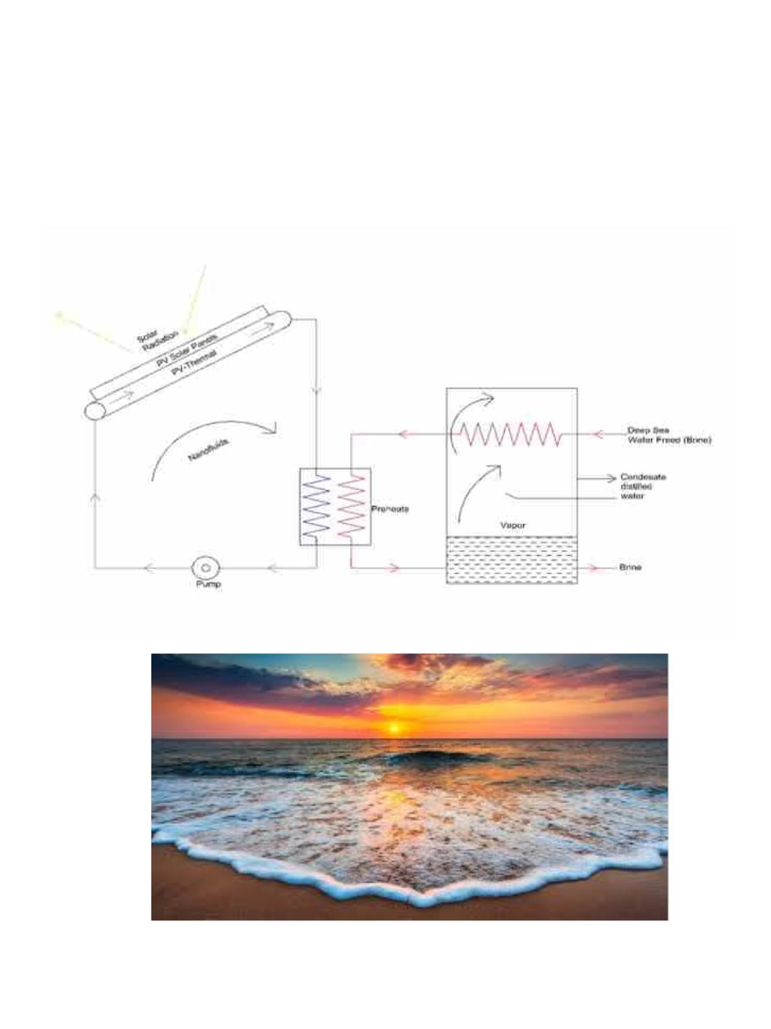
TransPacific Energy Desalination With
PV-Thermal

Slide 23
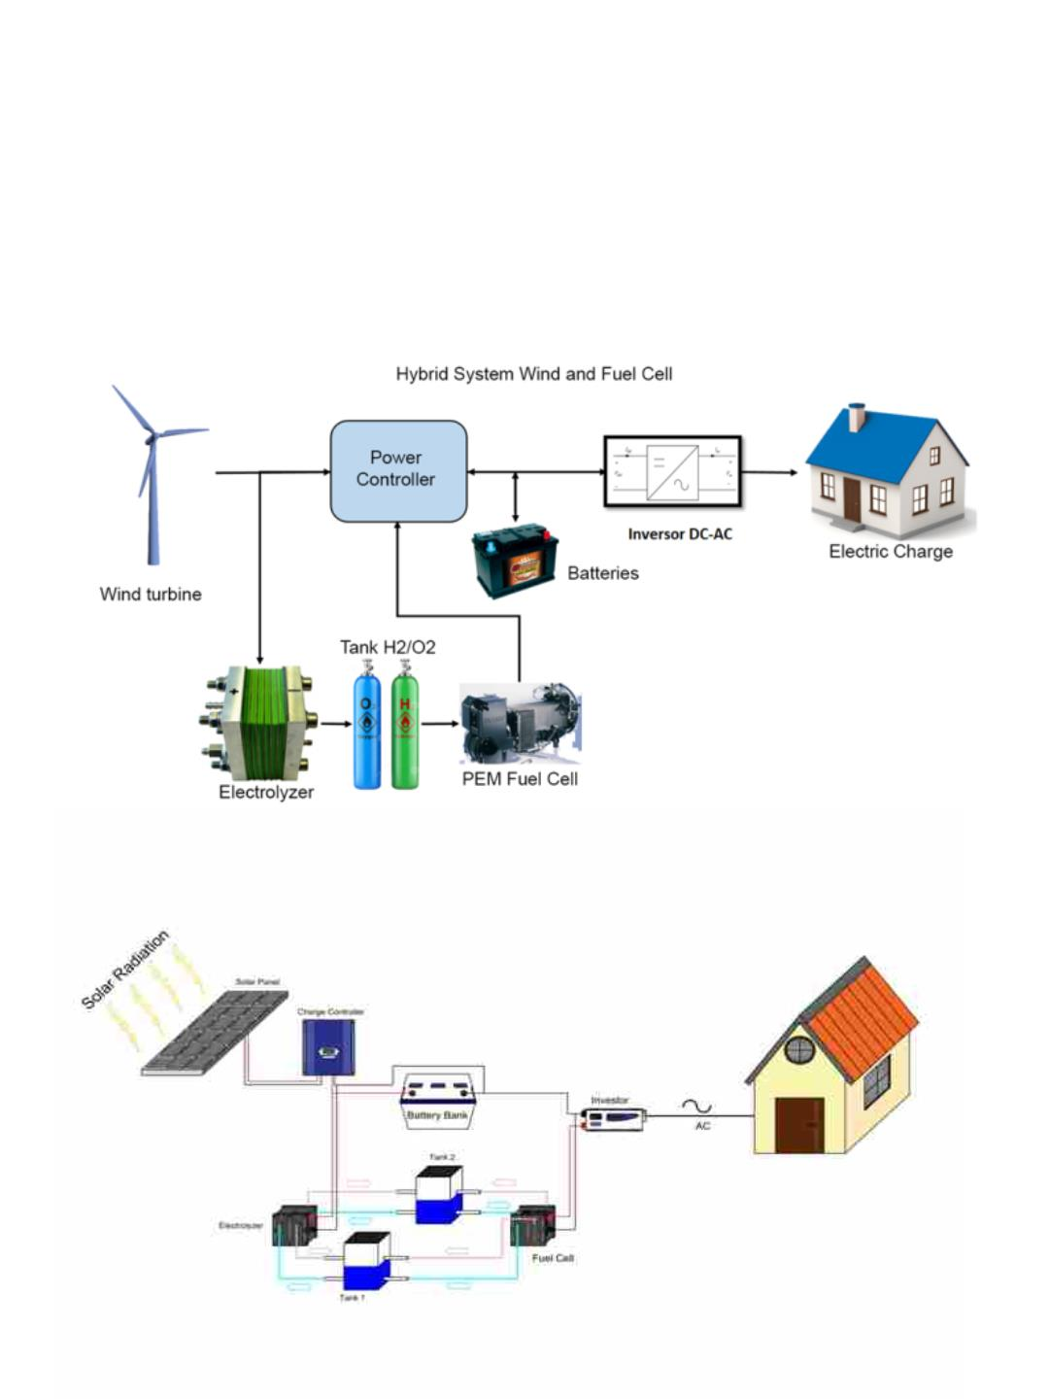
Fuel Cell driven by Solar and
Wind Energy for Hydrogen
Production

Slide 24
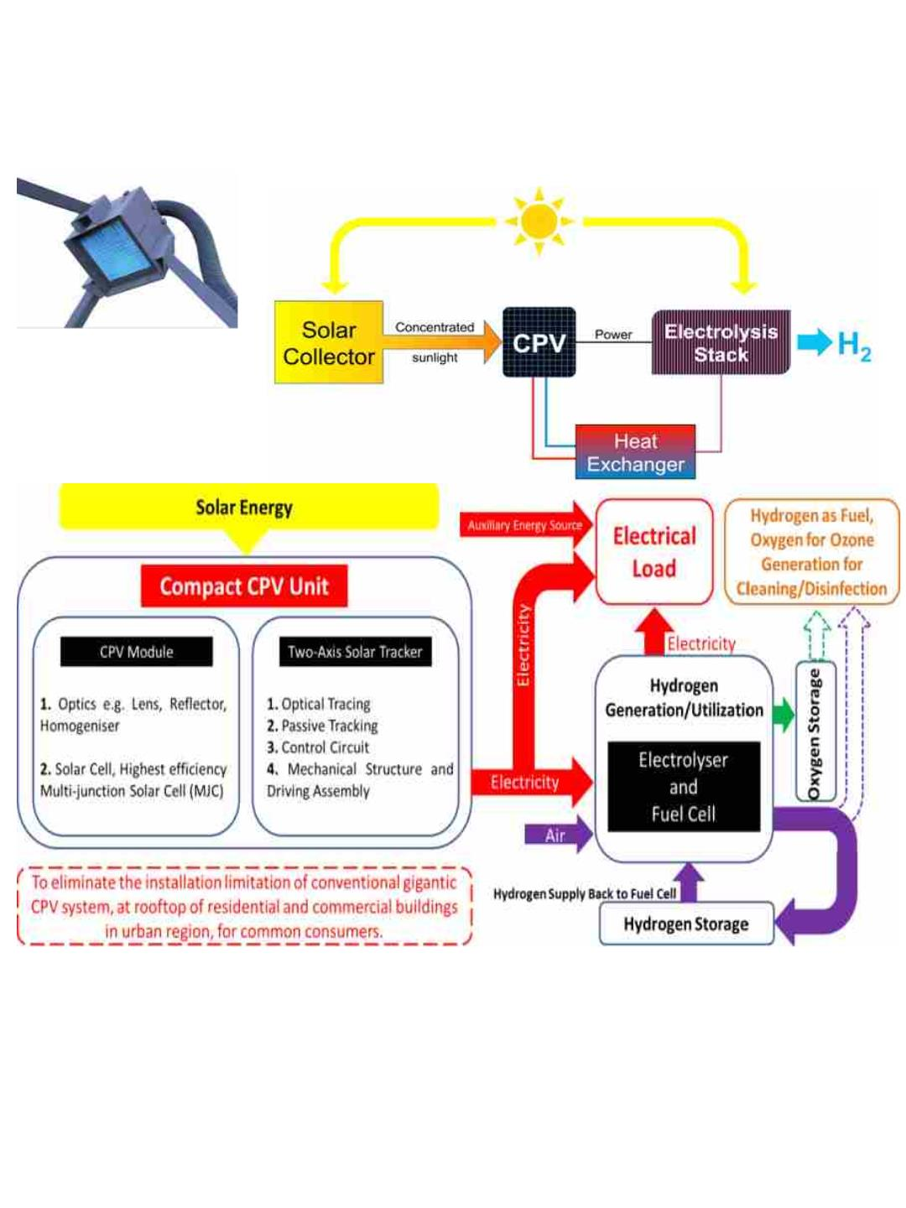
CPV and Hydrogen Production
CPV
Application & Core Benefits
• Technology: CPV Hydrogen Plant is more efficient than any other existing
Renewable Technologies.
• The overall energy efficiency of the Solar Hydrogen Plant is 28%.
• Economical: The lowest LCOH cost (1.38/kg H2) in the Hydrogen industry
(SMR $2.08/kg)
• It can produce Electricity - Levelized Cost of Electricity (LCOE) - $0.021/kWh

